Slide 1
Mid Term Dashboard
Table of Contents
Mid Term Dashboard
About Amazon
Business Maturity Level
Business Strategies
Aakarsh Dadha - 220260398
Data Sources
Data Warehouse Infrastructure
Proposed IT Infrastructure
Proposed Dashboard and Visualisation Report
Our Recommendation
Conclusion
References

Slide 2
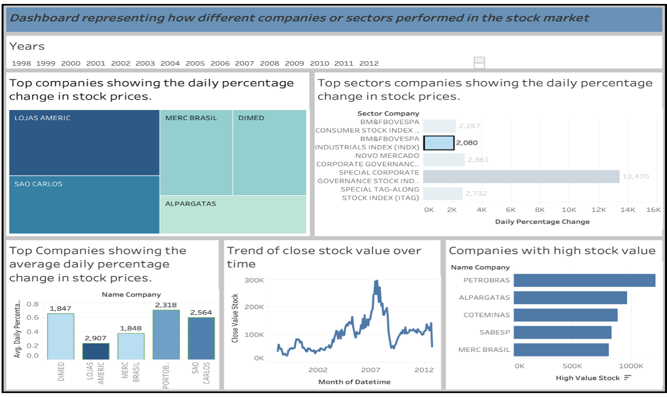
1.Mid Term Dashboard
Comments received on this particular sheet

Slide 3
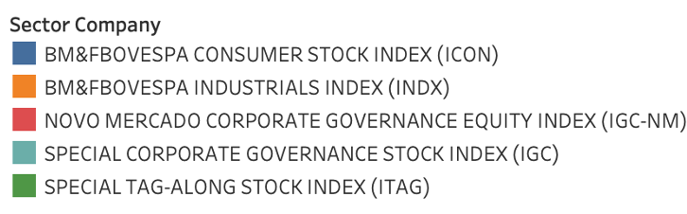
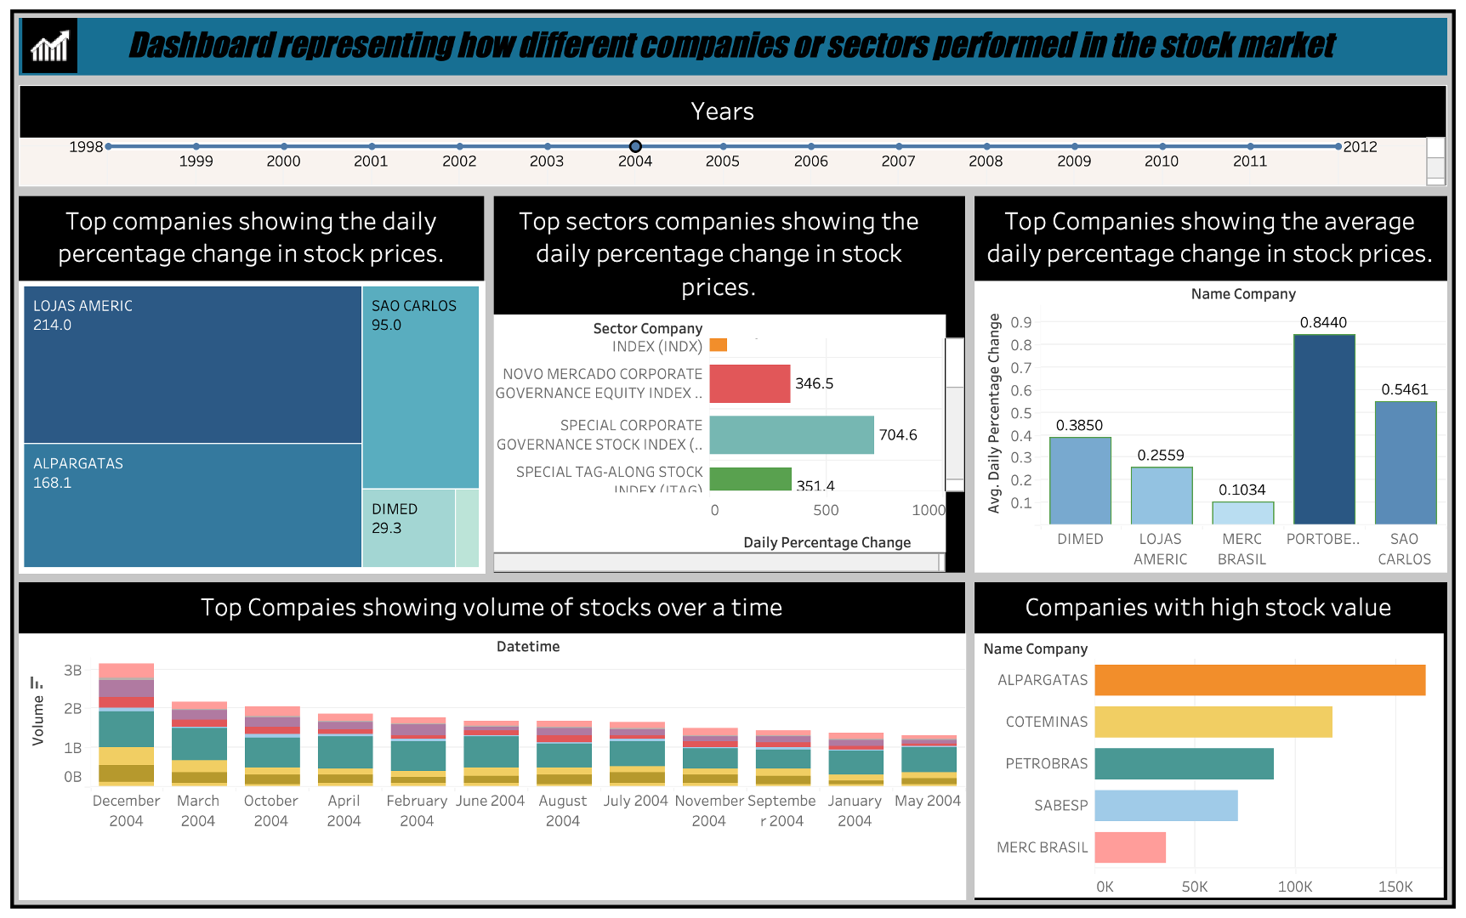
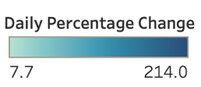
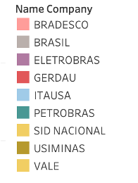
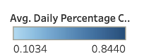
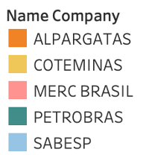
Modified Dashboard

Slide 4

Notes:
Image Source : https://www.peakpx.com/en/hd-wallpaper-desktop-kqdid

Slide 5
2.About Amazon.com,Inc
Created in 1994 by Jeff Bezos, an American.
The business first dealt in books but now sells a variety of other consumer goods.
Amazon is worth 1.26 Trillion USD thanks to its AWS, warehouses and cloud computing services
Headquarters in Seattle, Washington
Notes:
Amazon (2022). Facts. [online] About Amazon. Available at: https://www.aboutamazon.com/facts.
Amazon (2022). Facts. [online] About Amazon. Available at: https://www.aboutamazon.com/facts.

Slide 6
About Amazon.com,Inc
Type of Business
Operation & Infrastructure
IT Competency
Amazon is mainly an e-commerce firm.Also deals in cloud services, streaming and AI
Robust and dynamic infrastructure includes data centres, AWS and warehouses
E-commerce, cloud services, and logistics are all driven by infrastructure, which uses cutting-edge technology, automation, and data analytics to ensure smooth operations and satisfied customers.

Slide 7
3.Business Intelligence Maturity Level at Amazon
Current Level
Level to be Achieved
(Gartner, 2015) Based on the Gartner BI maturity model Amazon is at ”Level 5: Optimization"
The aim is to achieve a higher level of BI maturity, where predictive and prescriptive analytics are routinely used in strategic decision-making (Forbes , 2021).

Slide 8
Business Intelligence Maturity Level at Amazon
Amazon continuously improves its business intelligence capabilities.
Advanced analytics, data mining, and predictive modeling are all widely used.
Amazon has a data-driven culture and bases its decisions on data insights (Gartner, 2015).
Current Level
Level to be Achieved
Enhancing existing algorithms
Improving data literacy at all organizational levels
Increasing data processing speed and efficiency
Investigating new possibilities in predictive and prescriptive analytics
Automating more business operations
Maximizing the Use of Machine Learning (ML) Forbes , 2021).

Slide 9
Example: Maximizing the Use of Machine Learning
Amazon already makes substantial use of Machine Learning (ML), from demand forecasting to tailoring customer experiences. The recommended BI strategy can concentrate on deploying ML more broadly across the enterprise. For example, it could require creating advanced ML models to forecast market trends or find inefficiencies in supply chains. It might also involve training staff at all levels to understand and use ML models, hence enhancing data literacy and the culture of data-driven decision-making (Forbes , 2021).

Slide 10
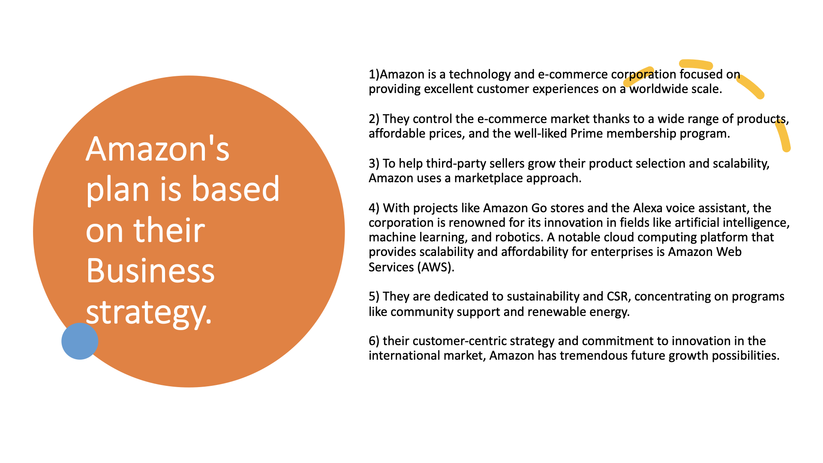

Slide 11
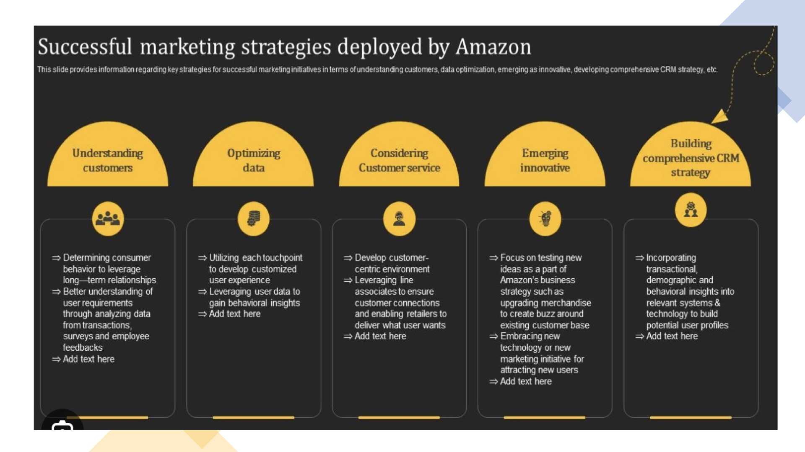

Slide 12
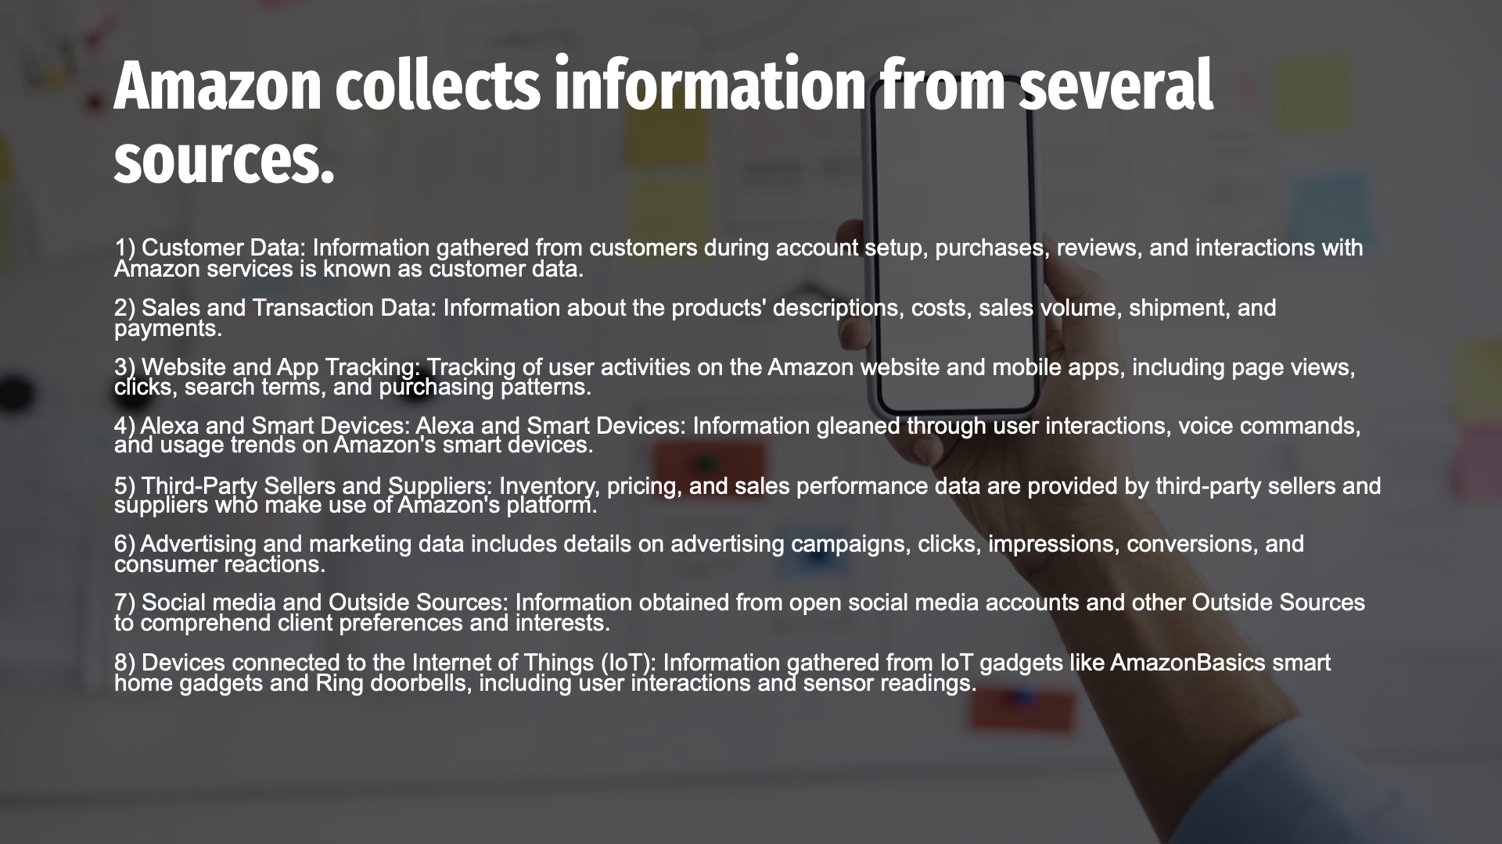

Slide 13
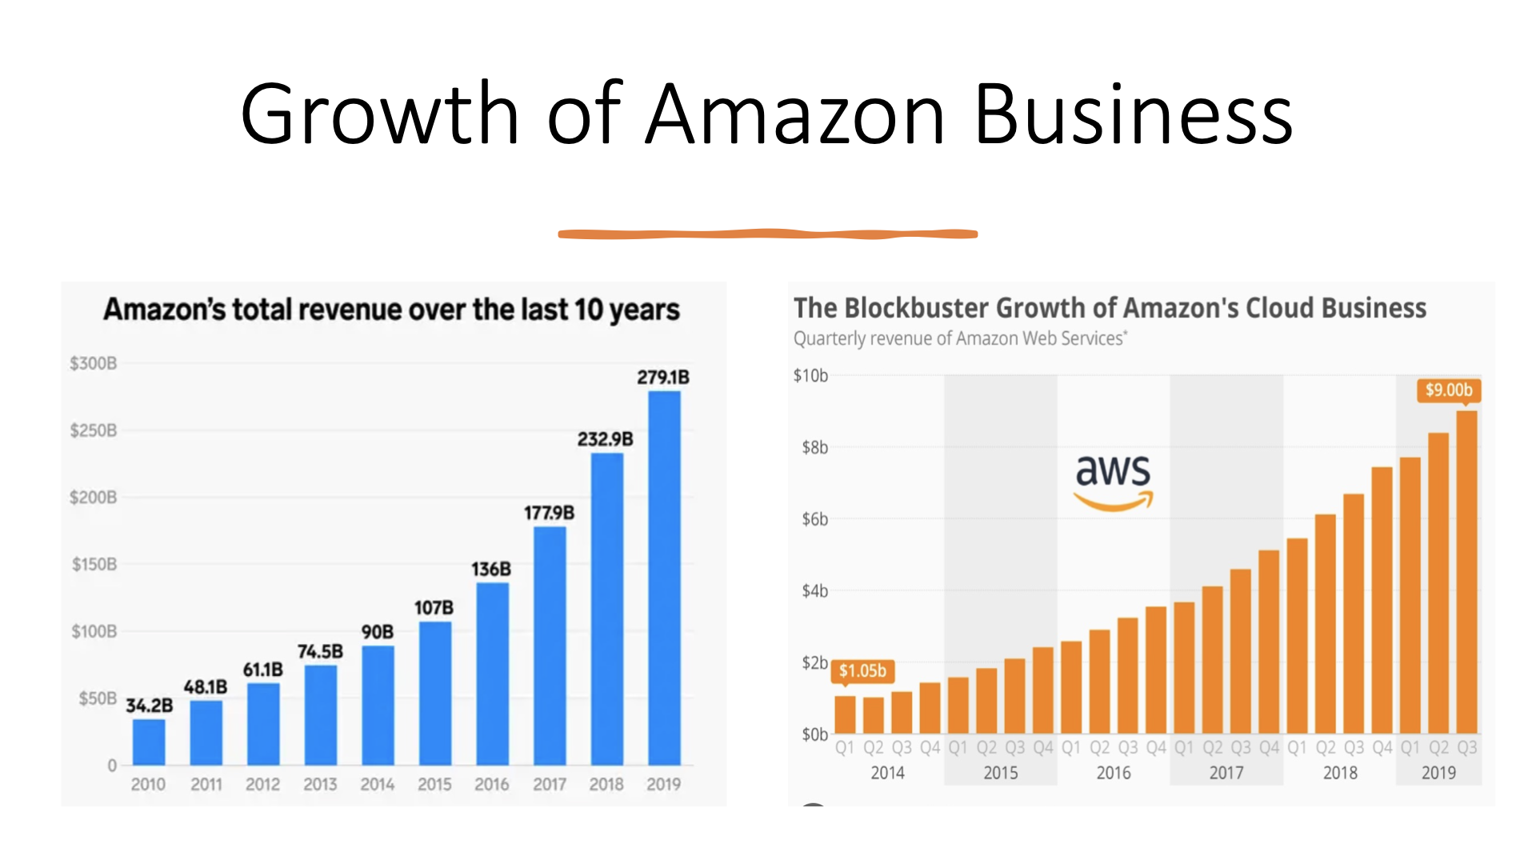

Slide 14
Data Warehousing Infrastructure of Amazon
In its data warehousing procedures, Amazon mostly uses an ELT (Extract, Load, Transform) strategy (GeneAka, 2022).
Amazon Web Services (AWS) offers a cloud-based data warehousing service called Amazon Redshift implements an ELT data warehousing system.
Extract
Load
Transform
Tools like AWS Database Migration Service, Amazon S3 are used to extract data from a variety of sources.
Amazon Redshift receives the extracted data and loads it using tools like the COPY command.
Using a SQL-based query engine, the Redshift cluster performs transformations and data processing that enables complex analytical queries and transformations for gaining insights and creating data models.
Notes:
https://genesis-aka.net/information-technology/professional/2022/02/08/build-a-modern-data-architecture-on-aws-with-amazon-appflow-aws-lake-formation-and-amazon-redshift-part-2/

Slide 15
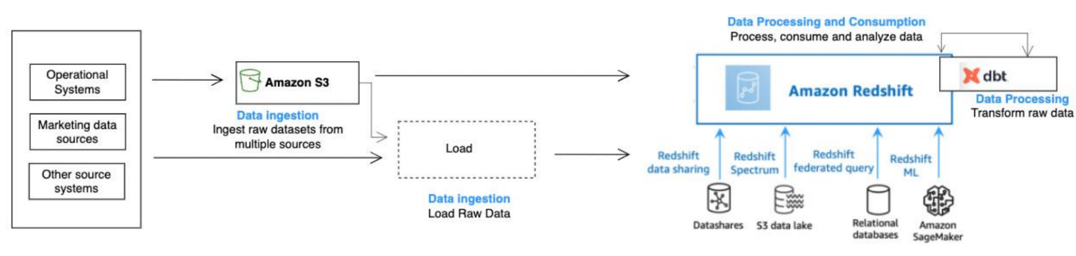
ELT Data Warehousing of Amazon -Amazon Redshift
AWS Database Migration Service
Amazon S3
Data Extraction
COPY Command
Amazon Kinesis Data
Firehose
Data Loading
Amazon Redshift Data Warehouse Infrastructure Components
Compute Nodes
Columnar Storage
Amazon Redshift Spectrum
Data Storage
Query Execution Engine
Amazon Redshift Compiler
Workload Management
Venus is the second planet from the Sun
Data Processing
Data Security
Encryption
Access Controls
VPC Connectivity
Notes:
Image source : https://d1.awsstatic.com/products/Redshift/Amazon-Redshift-dBT-Best-Practice_paper.pdf

Slide 16
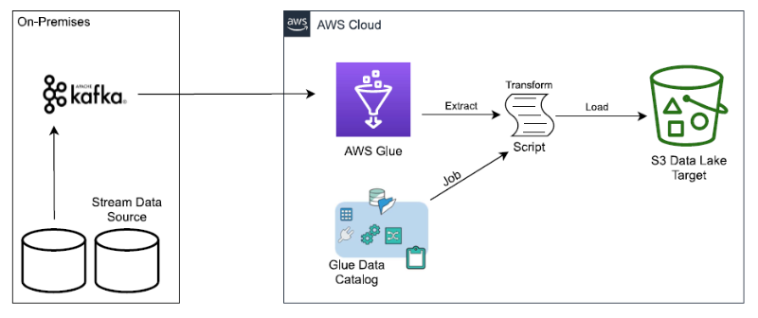
ETL Warehousing of Amazon- AWS Glue
Extract
Transform
Load
Notes:
Image source : https://aws.amazon.com/blogs/architecture/hybrid-cloud-architectures-using-self-hosted-apache-kafka-and-aws-glue/

Slide 17
Why ELT over ETL in Amazon?
Let's discuss why Amazon uses an ELT technique for data warehousing operations in more detail now (Amazon Web Services, Inc., n.d.).
Scalability and Performance
Cost Efficiency
Flexibility and Iterative Analysis
Simplified Data Pipelines
Notes:
https://aws.amazon.com/compare/the-difference-between-etl-and-elt/

Slide 18
Workflow of Stakeholders involved in Data Warehousing
1 2 3 4 5 6 7
Business Users
Data Engineers
Data Analysts
Data Scientists
Database Administrator
IT Operations
Management & Executives
Clearly state the data needs, offer feedback on insights, and use the data warehouse to aid in decision-making.
Work with business users to extract and transform data, create and maintain ETL procedures, and enhance the performance of data warehouses.
Work with business users to develop reports and dashboards, analyze and visualize data, and offer ad hoc analysis.
Work together with engineers and analysts to produce actionable insights by utilizing the data warehouse for advanced analytics.
Work with data engineers to establish backup and recovery plans, manage user access privileges, and monitor and maintain database performance and security.
Work with DBAs and data engineers to establish security measures, handle upgrades and configurations, and support the infrastructure.
Develop a data strategy, allot resources, and base decisions on information.

Slide 19
System Admin
1
4
Hardware
Servers (Mainly high availability)
Networking hardware like routers, switches and firewalls, access points and cables
Data centres ( a mix between on premise and cloud based infrastructure)
IT Infrastructure
Software
2
5
Data Storage and Management
Data Warehouse
SQL for data management
PowerBI or Tableau for data visualization
TensorFlow or PyTorch for machine learning implementations
Cloud
3
6
IT Support and Maintenance
AWS

Slide 20
Proposing a Dashboard
01
Goal
04
Metrics and KPI
02
Stakeholders
05
Visualisation
03
Data Source

Slide 21
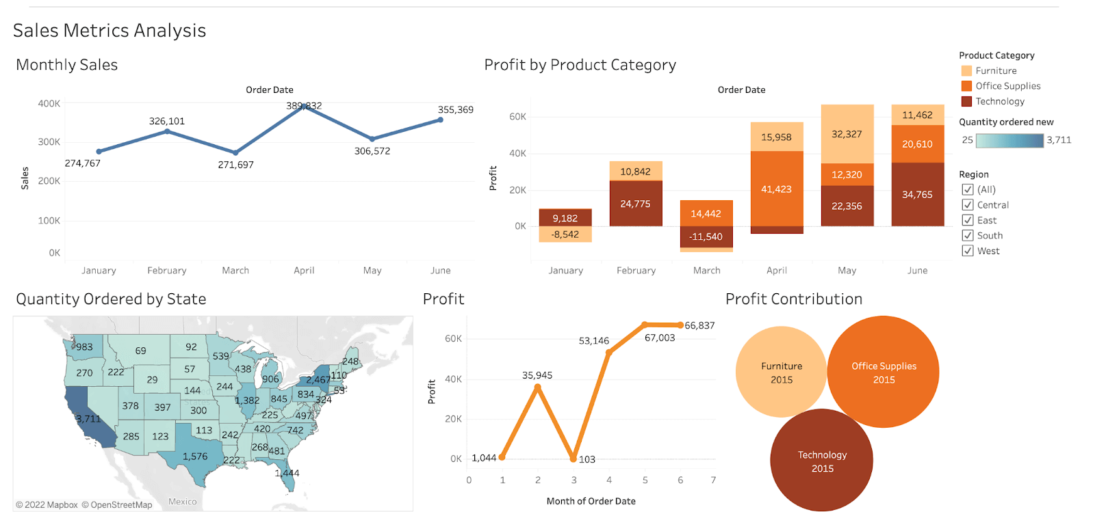
Profit contribution of product category
Goal -
Achieved -
Sales and Profit Analysis across product categories
Notes:
Image Source : https://public.tableau.com/app/profile/jayshree.wasnik/viz/SalesMetricsAnalysis_0/SalesMetricsAnalysis

Slide 22
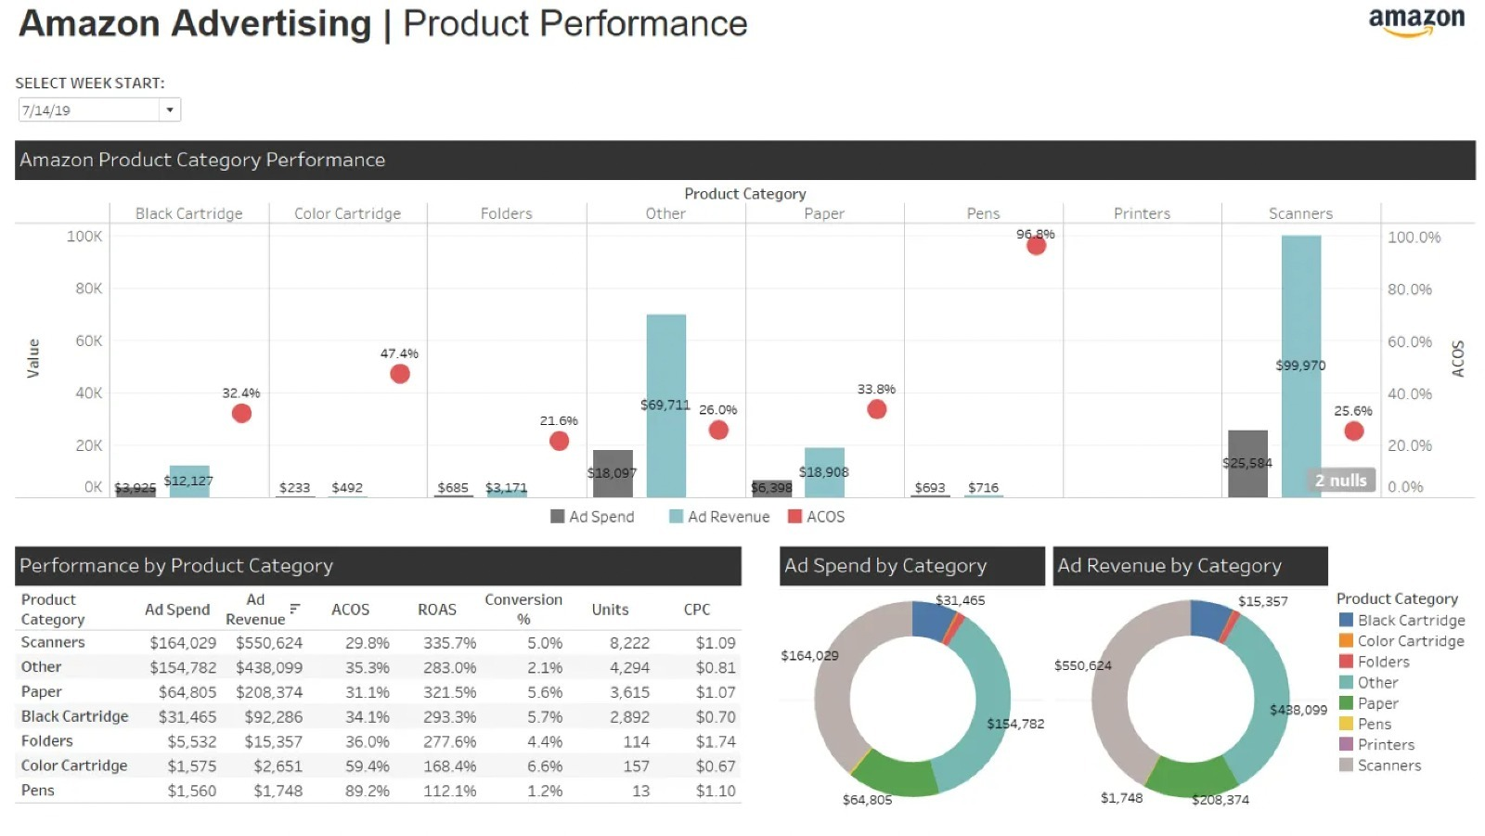
Goal -
Study the Advertising Costs for product segment
Achieved -
ROAS for product segment
Notes:
Image Source : https://blog.openbridge.com/tableau-ecommerce-5-tips-for-building-dashboards-e85f07fa0ef8

Slide 23
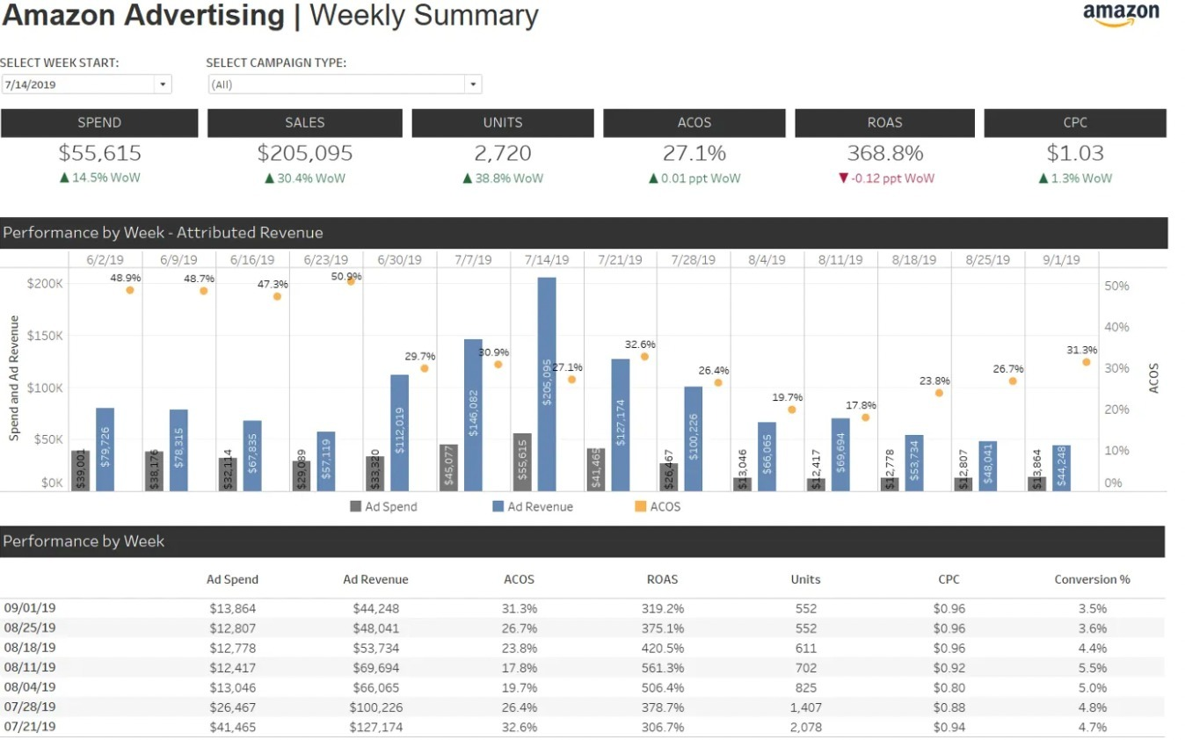
Study the Advertising Costs
Understanding of advertising expenses against returns
Goal -
Achieved -
Notes:
Image Source : https://blog.openbridge.com/tableau-ecommerce-5-tips-for-building-dashboards-e85f07fa0ef8

Slide 24
Our Recommendations
Amazon.com,Inc.
Quantity ordered by State
They can strengthen relations, localize offerings, understand the market and expand marketing in California as shown in the dashboard
Performance by Category
Can avoid ad spend on categories such as pens, color cartridges and printers as the revenue generated from it is insignificant
Enhance product discoverability
Optimize product discovery by recommending strategies to improve search rankings and product visibility.
Expand into new markets and sectors
Amazon’s success in diverse sectors like cloud computing, entertainment, and smart devices show their ability to diversify Exploring new customer centric markets can create growth opportunities

Slide 25
Conclusion on challenges we faced
Considering Amazon follows both ETL and ELT approach, it was difficult to understand and explain it as a whole.
Data Warehouse
Amazon handles a massive volume of data, and designing a scalable data warehousing solution requires careful consideration of all aspects.
Scalability
IT Infrastructure
Due to the advanced tech and new terminologies under hardware IT infrastructure, it was difficult to define it.
Conclusion
Dynamic Data
Amazon’s advertising metrics can change over time. Creating a dashboard to accommodate these changes is crucial
Complexity
Understanding and explaining Amazon's complex systems spanning e-commerce, cloud services, logistics, and more can be challenging.

Slide 26
References
Amazon (2022). Facts. [online] About Amazon. Available at: https://www.aboutamazon.com/facts.
Amazon Web Services, Inc. (n.d.). ETL vs. ELT - Comparing Data-Processing Approaches - AWS. [online] Available at: https://aws.amazon.com/compare/the-difference-between-etl-and-elt/.
aws.amazon.com. (2021). Hybrid Cloud Architectures Using Self-hosted Apache Kafka and AWS Glue | AWS Architecture Blog. [online] Available at: https://aws.amazon.com/blogs/architecture/hybrid-cloud-architectures-using-self-hosted-apache-kafka-and-aws-glue/.
Barney, N. (n.d.). What is AWS (Amazon Web Services) and How Does it Work? [online] SearchAWS. Available at: https://www.techtarget.com/searchaws/definition/Amazon-Web-Services#:~:text=AWS%20(Amazon%20Web%20Services)%20is.
Best Practices for Leveraging Amazon Redshift and dbtTM. (n.d.). Available at: https://d1.awsstatic.com/products/Redshift/Amazon-Redshift-dBT-Best-Practice_paper.pdf.
Forbes (2021). Amazon Web Services BrandVoice: Predicting The Future Of Demand: How Amazon Is Reinventing Forecasting With Machine Learning. [online] Forbes. Available at: https://www.forbes.com/sites/amazonwebservices/2021/12/03/predicting-the-future-of-demand-how-amazon-is-reinventing-forecasting-with-machine-learning/?sh=540102e21b6b [Accessed 2 Jun. 2023].
Gartner. (2015). ITScore Overview for BI and Analytics. [online] Available at: https://www.gartner.com/en/documents/3136418.
Gartner. (2015). ITScore Overvie
90%
70%
40%

Slide 27
References
GeneAka (2022). Build a modern data architecture on AWS with Amazon AppFlow, AWS Lake Formation, and Amazon Redshift: Part 2. [online] Global Intelligence and Insight Platform: IT Innovation, ETF Investment. Available at: https://genesis-aka.net/information-technology/professional/2022/02/08/build-a-modern-data-architecture-on-aws-with-amazon-appflow-aws-lake-formation-and-amazon-redshift-part-2/ [Accessed 2 Jun. 2023].
Spicer, T. (2023). Tableau Ecommerce: 5 Tips For Building Dashboards. [online] Medium. Available at: https://blog.openbridge.com/tableau-ecommerce-5-tips-for-building-dashboards-e85f07fa0ef8 [Accessed 2 Jun. 2023].
W, J. (2023). Sales Metrics Analysis. [online] Tableau.com. Available at: https://public.tableau.com/app/profile/jayshree.wasnik/viz/SalesMetricsAnalysis_0/SalesMetricsAnalysis [Accessed 2 Jun. 2023].
90%
70%
40%

